Slide 1
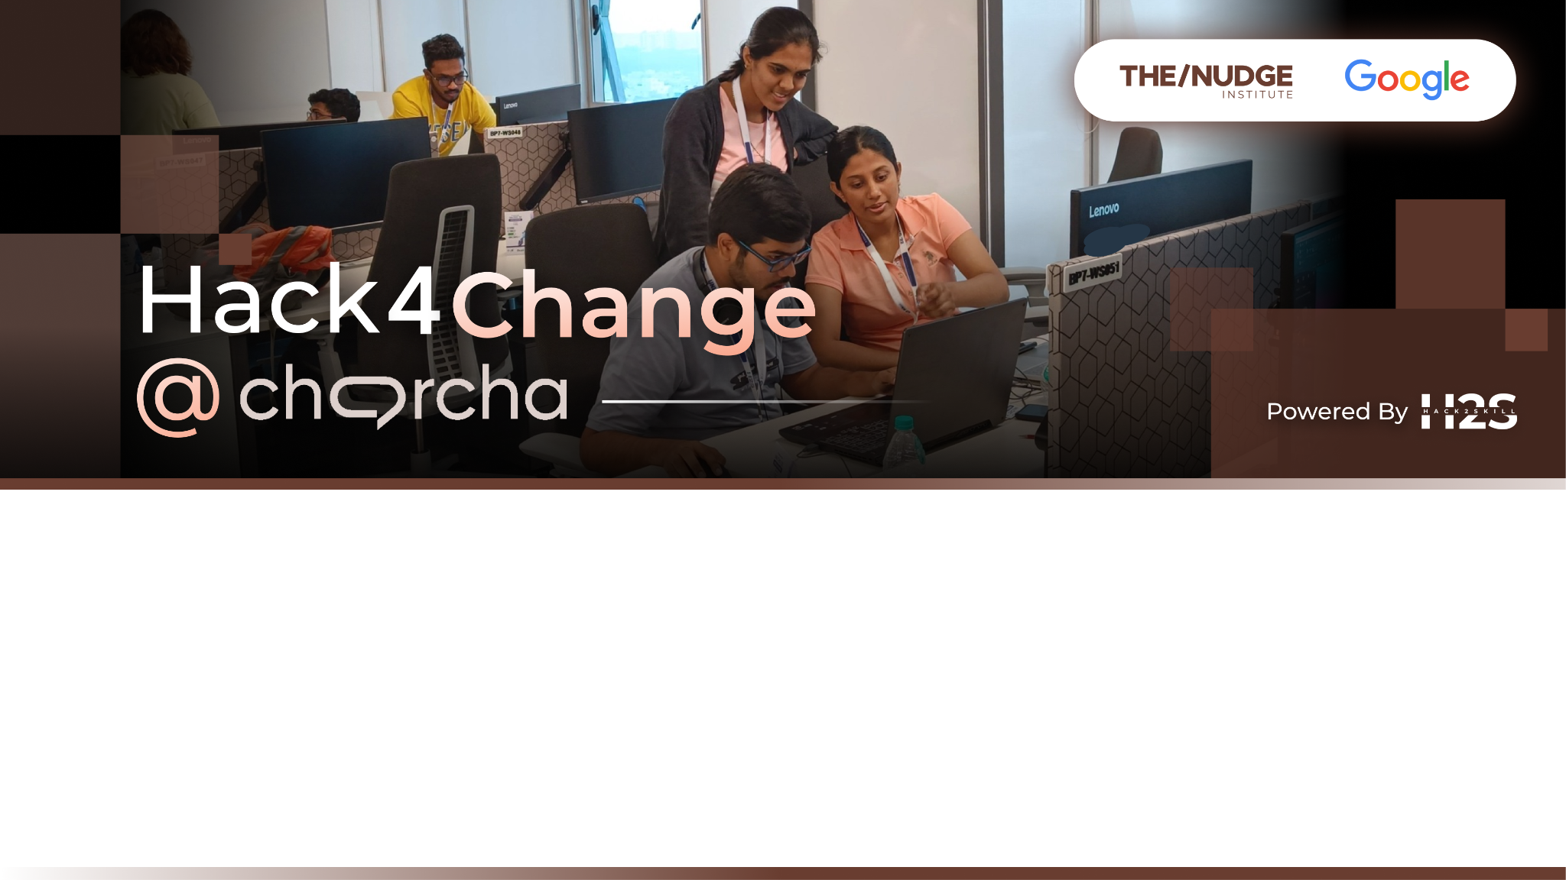
Team Details
Team Name: Conqueror
Team Leader Name: Deep Samanta
Problem Statement: Smallholder farmers face challenges in adopting sustainable practices due to limited real-time data, overuse of fertilizers, and unpredictable weather patterns, necessitating urgent solutions for resilient agriculture.

Slide 2
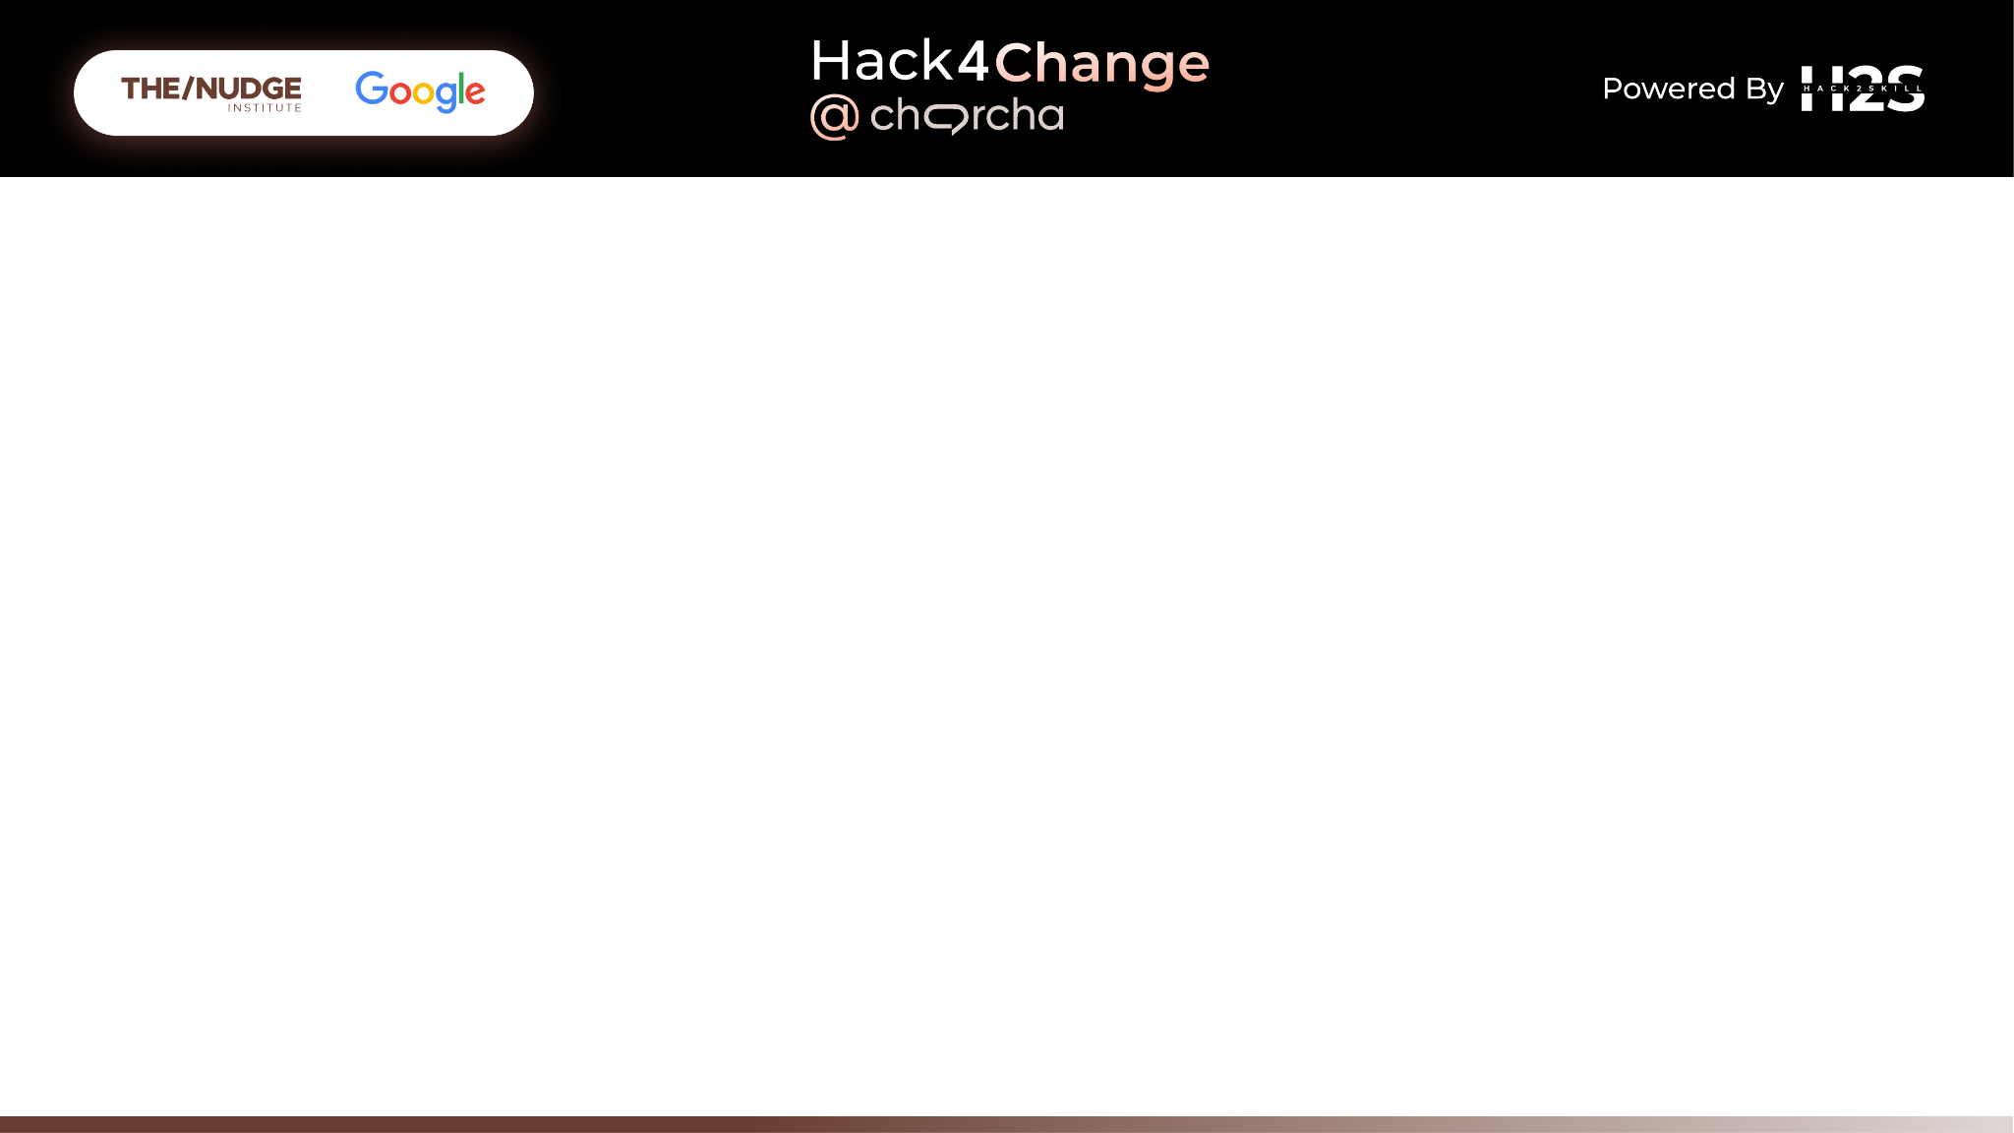
Brief about the Idea: The proposed solution is a comprehensive, all-in-one AI/ML system designed to address the multifaceted challenges faced by smallholder farmers. By integrating IoT, AI, drones, and blockchain technologies, the solution provides real-time data collection and analysis, which enables data-driven decision making. This allows farmers to optimize sowing, irrigation, and harvesting processes. Additionally, the system includes precision irrigation management and remote control of irrigation systems to ensure efficient water usage, which minimizes waste and improves crop yields. AI-based diagnostics offer early detection of crop health issues, allowing for timely interventions. The decision support system helps farmers adapt to climate change by recommending optimal crop choices and planting times based on predicted weather patterns. Financial vulnerabilities due to extreme weather events are mitigated through blockchain-powered climate risk insurance, which provides automated payouts based on predefined weather conditions. The solution's unique selling proposition lies in its real-time insights and actions delivered via mobile notifications and megaphones, its scalability, and its focus on promoting sustainable farming practices. This comprehensive approach differentiates it from existing solutions that typically address only specific aspects of farming challenges.

Slide 3
Opportunities
How different is it from any of the other existing ideas?
Integration of Multiple Technologies: This solution combines IoT, AI/ML, blockchain, and drone technologies in a cohesive manner, unlike many existing solutions which might focus on one or two aspects.
Real-Time Data and Feedback: Provides real-time data collection and feedback to farmers through mobile apps and megaphones, ensuring timely interventions.
Precision and Adaptation: Utilizes precision agriculture techniques and climate adaptation strategies, offering tailored recommendations based on specific farm conditions.
How will it be able to solve the problem?
Data-Driven Decision Making: Real-time data collection and AI analysis will help farmers make informed decisions about sowing, irrigation, and harvesting.
Efficient Resource Management: AI-driven water management and remote irrigation control will optimize water usage, reducing waste and improving crop yields.
Early Detection of Issues: AI-based crop health diagnostics will detect stress, pests, and diseases early, enabling timely interventions.
Climate Adaptation: Decision support systems will help farmers adapt to changing weather patterns, selecting the best crops and planting times.
Financial Security: Blockchain-powered climate risk insurance will provide financial protection against extreme weather events
USP of the proposed solution:
Comprehensive Approach: An all-in-one solution addressing multiple challenges faced by smallholder farmers.
Scalable solution that can be customized and expanded to meet the needs of various farming contexts and scales
Sustainability Focus: Promotes sustainable farming practices by optimizing resource use and reducing environmental impact.

Slide 4
List of features offered by the solution:
An all-in-one AI/ML solution for smallholder farmers integrates crop yield prediction, IoT-based farm monitoring, precision drip irrigation, remote irrigation control, crop health diagnostics, climate adaptation support, and blockchain-powered climate risk insurance.
By analyzing historical data, real-time sensor inputs, and weather forecasts, this solution optimizes planting, irrigation, and resource management, enhances early detection of crop health issues, recommends adaptive practices for climate change, and provides financial security against extreme weather events.
This comprehensive approach ensures sustainable farming, reduces environmental impact, and enhances resilience in the face of climatic uncertainties directly to the famers in the form of mobile messages/ notifications or announcements made on megaphones installed in the fields of the farmers. Possible implantation of an app interface depending upon the accessibility of the farmers.

Slide 5
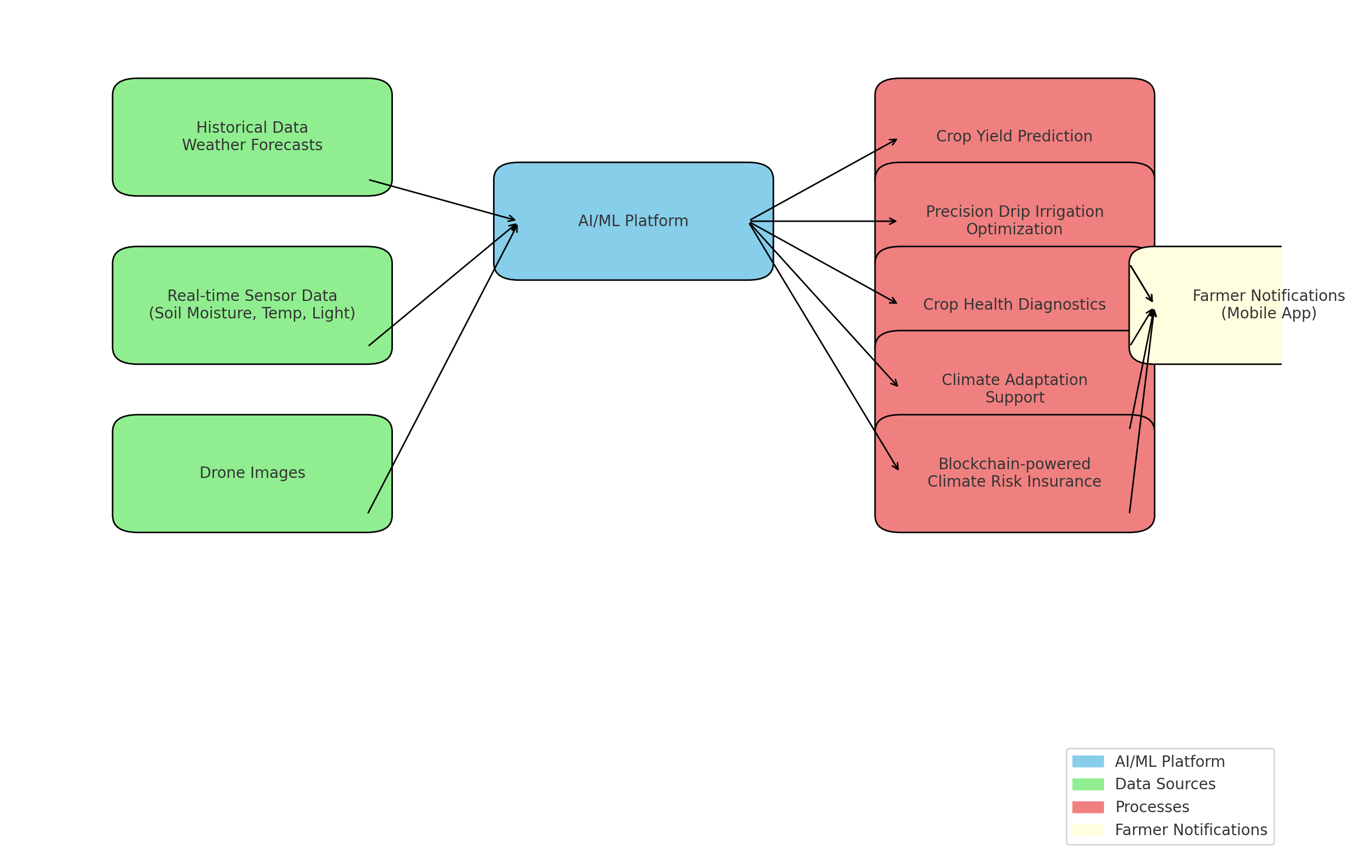
Detailed description of the process flow:
Data Collection
Sensors: Soil moisture, temperature, light, and other environmental sensors are installed in the fields.
IoT Devices: Collect real-time data from the sensors.
Drones: Capture aerial images for crop health monitoring.
Data Transmission
Sensor Networks: Send data to central servers via IoT gateways.
Drone Data Upload: Transfer images to the cloud for processing.
Data Storage
Cloud Storage: Centralized storage for all collected data.
Data Processing & Analysis
Machine Learning Models: Analyze historical data, weather forecasts, and real-time farm data.
AI Algorithms: Process sensor data to predict crop yields, optimize irrigation, detect crop health issues, and recommend climate adaptation strategies.
Decision Support System
AI Recommendations: Generate actionable insights and recommendations for farmers.
Precision Irrigation Schedules: Optimize water usage based on real-time data.
Notification System
Mobile Apps: Send push notifications to farmers with timely alerts (e.g., incoming rain, irrigation needs, crop health issues).
Megaphones: Broadcast important alerts in the fields (e.g., half an hour warning before rain).
User Interface
Mobile App Interface: Farmers receive notifications, view data dashboards, and control irrigation systems.
Web Dashboard: Accessible via mobile and desktop for detailed insights and remote monitoring.
Feedback Loop
Farmer Inputs: Farmers can provide feedback or manually input additional data (e.g., observations about crop health).
System Updates: The system updates models and recommendations based on new data and feedback.
Process flow diagram or Use-case diagram:

Slide 6
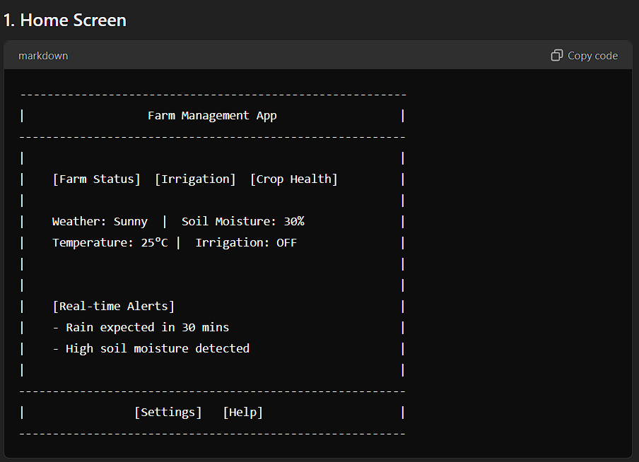
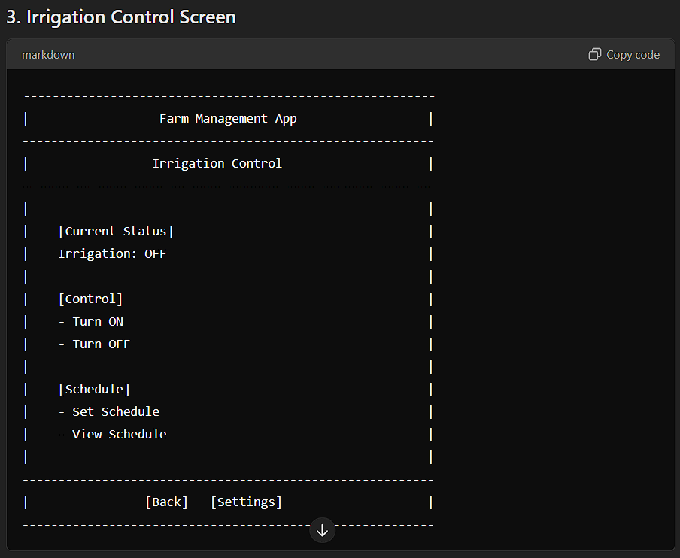
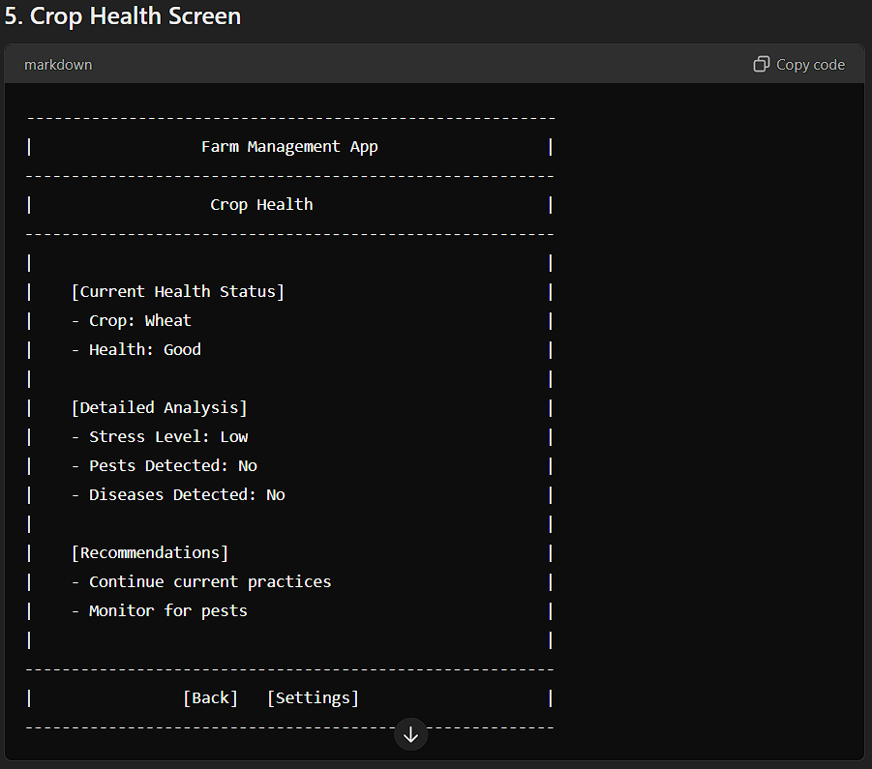
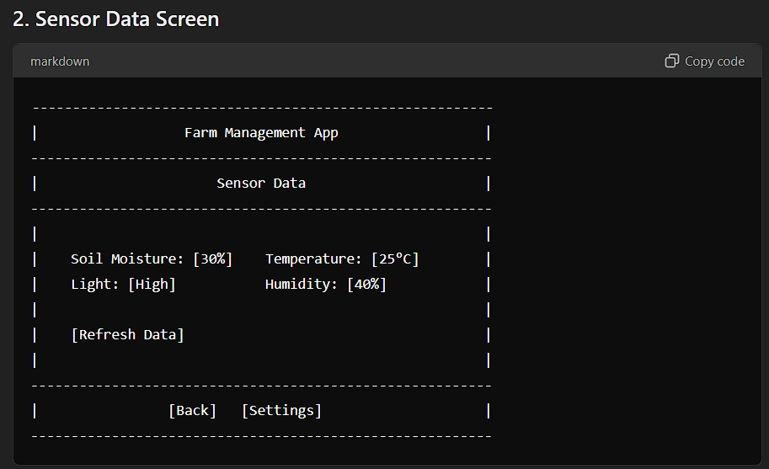
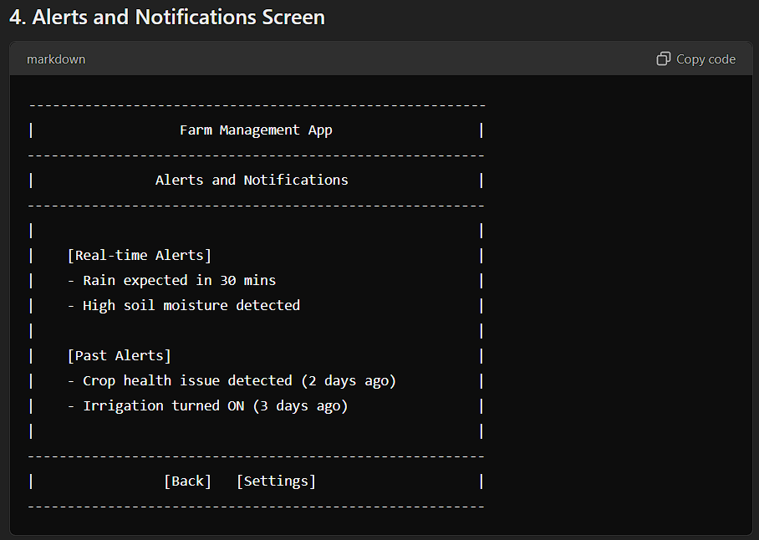
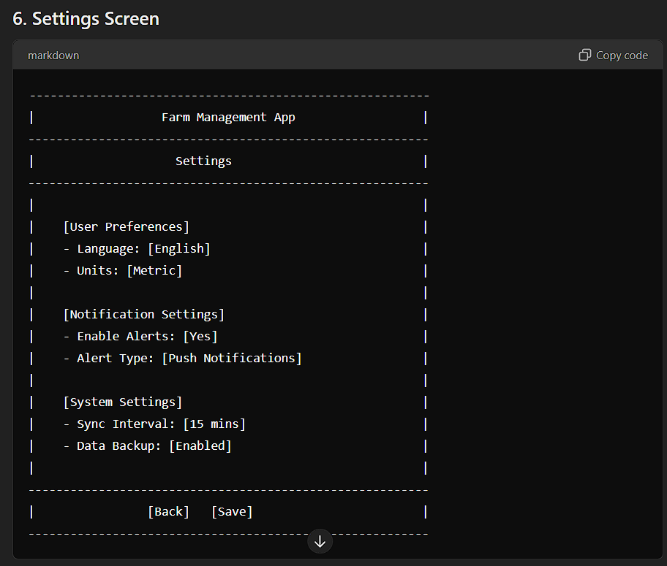
Wireframes/Mock diagrams of the proposed solution (optional)

Slide 7
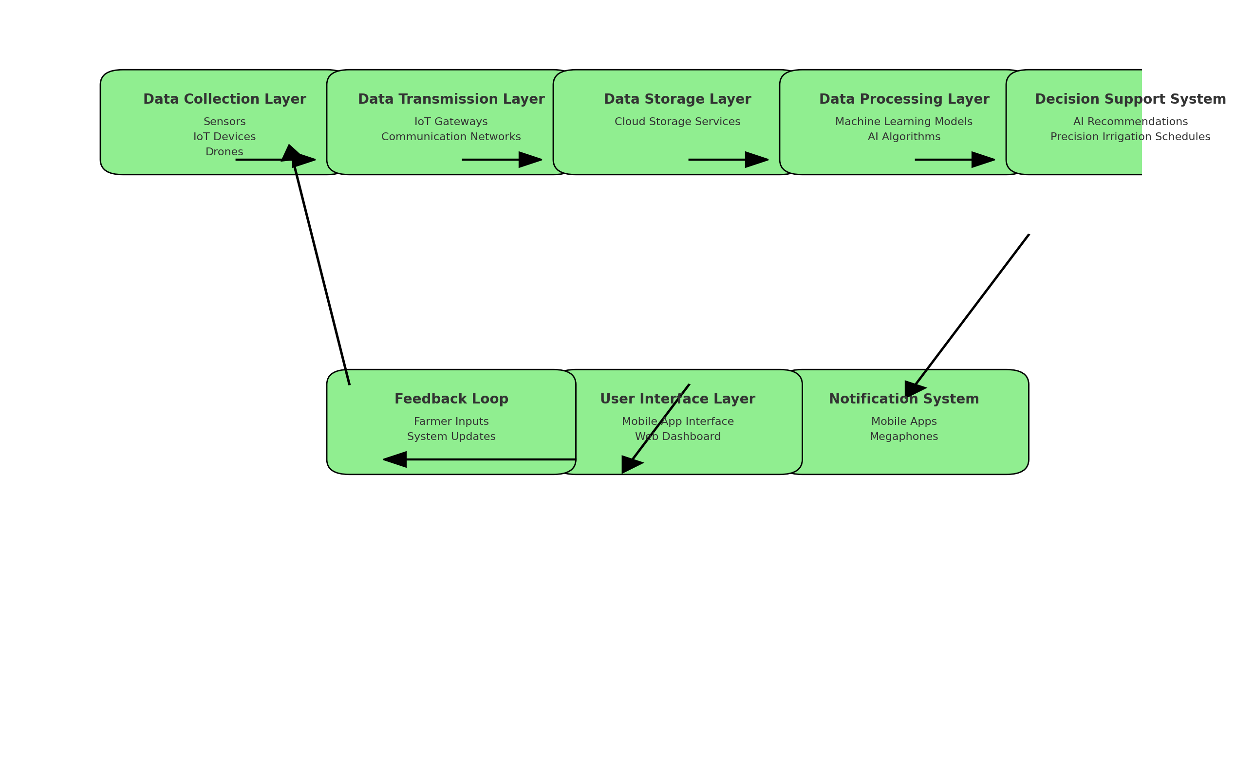
Architecture diagram of the proposed solution
The architecture diagram will include the following components:
Data Collection Layer:
Sensors (Soil moisture, temperature, light)
IoT Devices
Drones
Data Transmission Layer:
IoT Gateways
Communication Networks (WiFi, Cellular, etc.)
Data Storage Layer:
Cloud Storage Services
Data Processing Layer:
Machine Learning Models
AI Algorithms
Decision Support System:
AI Recommendations
Precision Irrigation Schedules
Notification System:
Mobile Apps
Megaphones
User Interface Layer:
Mobile App Interface
Web Dashboard
Feedback Loop:
Farmer Inputs
System Updates

Slide 8
Technologies to be used in the solution
1. Data Collection Layer
Hardware:
Sensors: Soil moisture sensors, temperature sensors, light sensors, humidity sensors, etc.
Example products: Decagon 5TM, Sentek Drill & Drop, Davis Instruments 6450 Vantage Pro2
IoT Devices: Devices for capturing and transmitting sensor data.
Example products: Arduino, Raspberry Pi, ESP8266
Drones: For capturing aerial images of crops.
Example products: DJI Phantom 4, Parrot Bluegrass Fields
Software:
Firmware: Custom firmware for sensors and IoT devices.
Example tools: Arduino IDE, PlatformIO
2. Data Transmission Layer
Hardware:
IoT Gateways: Gateways to collect data from sensors and transmit it to the cloud.
Example products: Cisco IR1101, MultiTech Conduit
Communication Networks: WiFi, Cellular (3G/4G/5G), LoRaWAN for long-range communication.
Example products: SIMCOM SIM7600, LoRa modules (e.g., RAK Wireless)
Software:
Protocols: MQTT, HTTP, CoAP for data transmission.
Example tools: Mosquitto (MQTT broker), Node-RED (flow-based programming for IoT)

Slide 9
Technologies to be used in the solution
3. Data Storage Layer
Software:
Cloud Storage Services: To store large amounts of data securely.
Example providers: AWS S3, Google Cloud Storage, Azure Blob Storage
4. Data Processing Layer
Software:
Machine Learning Models: Models for analyzing historical data, predicting crop yields, and detecting anomalies.
Example frameworks: TensorFlow, PyTorch, scikit-learn
AI Algorithms: Algorithms for processing real-time data and generating recommendations.
Example algorithms: Random Forest, Gradient Boosting, LSTM (for time series forecasting)
Data Processing Pipelines: Tools for managing and processing data.
Example tools: Apache Kafka, Apache Spark, Google Dataflow
5. Decision Support System
Software:
AI Recommendations Engine: To provide actionable insights based on analyzed data.
Example tools: Custom AI models developed using TensorFlow, scikit-learn
Precision Irrigation Scheduling: Algorithms to optimize irrigation based on soil moisture and weather data.
Example tools: Custom scheduling algorithms, integrating weather APIs (e.g., OpenWeatherMap)

Slide 10
Technologies to be used in the solution
6. Notification System
Software:
Mobile Apps: To send notifications and alerts to farmers.
Example tools: React Native, Flutter, Android Studio, Xcode
Megaphones: IoT-connected megaphones for broadcasting alerts in the fields.
Example products: Custom-built megaphones with IoT connectivity using Raspberry Pi or Arduino
Push Notification Services: To deliver notifications to mobile devices.
Example services: Firebase Cloud Messaging (FCM), Apple Push Notification Service (APNS)
7. User Interface Layer
Software:
Mobile App Interface: User-friendly interface for farmers to interact with the system.
Example tools: React Native, Flutter, Swift (iOS), Kotlin (Android)
Web Dashboard: For detailed insights and remote monitoring.
Example tools: React.js, Angular, Vue.js, D3.js for data visualization

Slide 11
Technologies to be used in the solution
8. Feedback Loop
Software:
Data Collection from User Inputs: Mechanisms for farmers to input additional data and feedback.
Example tools: Form integrations in mobile apps and web dashboards, Google Forms
System Updates: Regular updates to AI models and algorithms based on new data.
Example tools: Continuous Integration/Continuous Deployment (CI/CD) pipelines, Jenkins, GitHub Actions
Integration and Middleware
API Gateway: To manage API calls between different components.
Example products: AWS API Gateway, Google Cloud Endpoints, Kong
Backend Services: For handling business logic and data processing.
Example frameworks: Node.js, Django, Flask, Spring Boot
Database: For storing structured data.
Example products: PostgreSQL, MySQL, MongoDB
Security
Authentication and Authorization: To secure access to the system.
Example services: OAuth, JWT, AWS IAM
Data Encryption: To protect data at rest and in transit.
Example tools: SSL/TLS, AES encryption
Monitoring and Maintenance
Monitoring Tools: To track system performance and health.
Example tools: Prometheus, Grafana, AWS CloudWatch
Error Tracking: To detect and resolve issues.
Example tools: Sentry, New Relic

Slide 12
